Slide 1

Pollution Air levels Analysis IN NYC
Ing. Mario Alberto Garcia Lopez

Slide 2
Introduction
In this analysis we are going to present the indicators that are contributing to the air pollution in NYC, these indicators provide a perspective across time and NYC geographies to better characterize air quality and health in NYC.
This information helps to determine conclusions and recommendations that improves the key indicators

Slide 3
Data exploration
Table: AirQuality_20250414
Data Quantity: 18862
Columns:
Unique ID: Integer
Indicator ID: Integer
Name: Text
Measure: Text
Measure Info: Text
Geo Type Name: Text
Geo Join ID: Integer

Slide 4
Data Exploration
Geo Place Name: Text
Time Period: Text
Start_Date: Date
Data Value: Float (Decimal Number)

Slide 5
Steps
Do the data exploration to identify the data we have and how we are going to use it to get insights
I identify that there is several rows we are not going to use for this specific project like Annual miles, diseases provocated by the polluted air and the deaths caused by polluted particles, etc. So in Power Query I decided to filter only the rows I am going to use in the project that are the ones that in the column “Name” we got the value “Fine particles (PM 2.5)”. Note: I decided to stay with the ones of “Ozone (O3)” and “NO2” to stay with those type of gases who also I can use for some insights.
I figure out that there is not data for PM10 only for PM2.5, NO2, O3. So instead of making insights for PM10 I will use the previously mentioned particles and gases who contributes to air pollution

Slide 6
STEPS
Also there is no data from daily average temperature on the data provided in the dataset so it is impossible to consider the variable in the report
I add two more columns to have more helpful variables that is extracting the day and the year.
I put an extra column named Season because in time period we got the Season divided by year so it was easier if I only split it into 2 variables (I leave the annual average data the same but I decided to change the Season ones)
I added a new column named part of Week by getting the type depending on the day
I added a new table only with information about visits to the Asthma emergency department visits due to PM2.5. I couldn’t make the relationship between them because the unique ID for every row is different

Slide 7
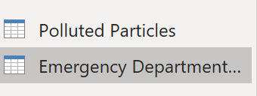
STEPS
For the new table I copy the table with the same values of the one I use before I just sort it by “Asthma emergency department visits due to PM2.5” and named it Emergency Department Visits. The first table I put “Polluted Particles”.
I change the variable “Data Value” in both tables naming “Particles” in the report I use for the particles and “Visits” to the one on visits to the asthma emergency department

Slide 8
Assumptions
I infer that the current year is 2023 because the information of June (Not present) is not in the data yet.
There is no particle values for certain boroughs depending on the year so I infer there is no data registered on those years.
With a dataset presenting so many values for different purposes I am going to use average as reference instead of sum because it is a better parameter to get the insights.
There is no data about daily temperature so I can’t generate an exact correlation about that value

Slide 9
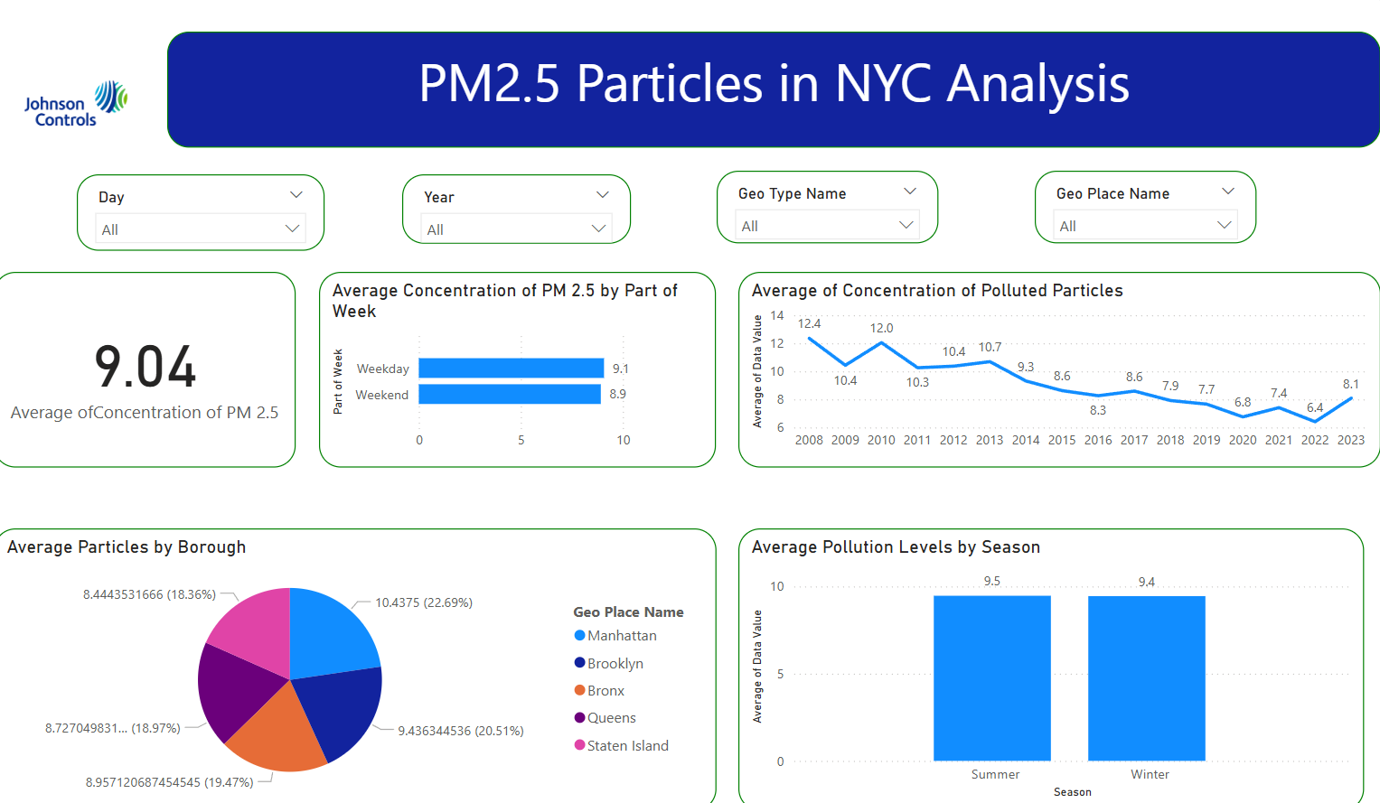
The dashboard
In the dashboard I decide to put 3 dropdown filters. Name that is the Name of the particle we are going to use in the page, Day of the Week and Year. This will help us to interact with the graphs and get the insights we want but also help us to get additional insights without adding more graphs to the report.
I decided to put 3 dashboard pages presented by the source of the pollution. The types are the PM2.5 , NO2, and O3.

Slide 10
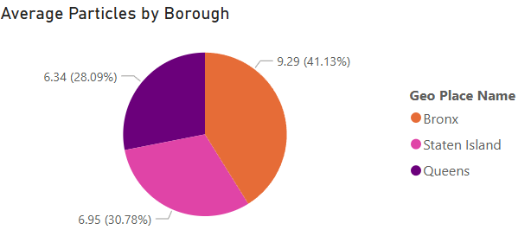
Average Pm 2.5 concentrations per Borough in 2022-2023
In this visualization we see a Pie Chart of the Average Particles divided by Borough.
In this graph we see that the Bronx along 2022 and the report on January 2023 the borough with most average particles is the Bronx with a value of 9.3 mcg/m3 and there is 2 Boroughs who doesn’t present data (Manhattan and Brooklyn)

Slide 11
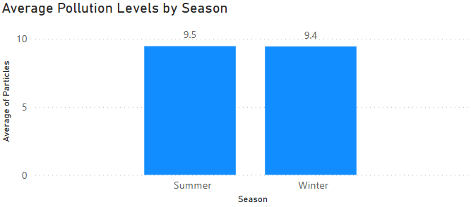
Pollution levels of pm2.5 by season
In this pie chart we use the variables Season and Average Pollution levels of the particles PM 2.5 showing them by Season (Summer or Winter). We got that the average pollution levels are almost equal on both seasons though the years 2010-2023.

Slide 12
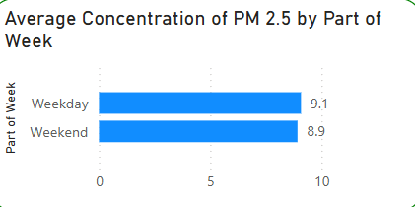
Pollution levels per part of week
Average on pollution levels are almost the same for the each of the parts of the week (Weekday and Weekend). There is a value of 8.9 in Weekend and 9.1 in Weekday so there’s not so much difference between the two.

Slide 13
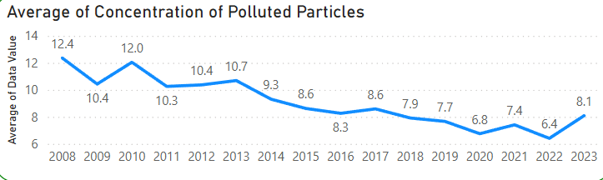
Average pm2.5 Particles behavior through years
In this line graph we show the behavior of the average of Concentrations of PM2.5 per year. In the graph shows that the highest average is in 2008 with the given data and the lowest value was in 2022 with 6.4 mcg/m3 as the value.
There is a constant fall between 2013 and 2016. Now the first part of 2023 is in 8.1 mcg/m3

Slide 14
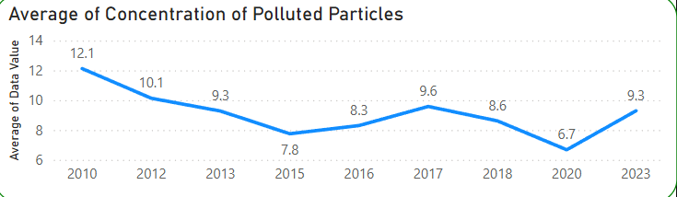
How has the concentration change over the years in the Bronx?
In this line graph we see how the average concentration of PM 2.5 is changing through the years in the Bronx that is the borough with more average particles found on the past year.
We see that there was a constant fall between 2010 and 2015. The largest value was in 2010 getting an average of 12.1 mcg/m3 and the lowest value was presented in 2020 with an average of 6.7 mcg/m3

Slide 15
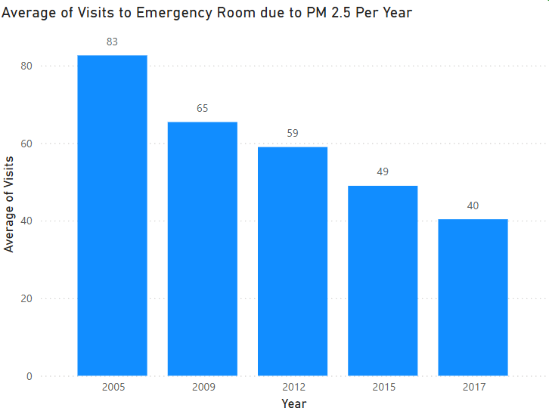
Average visits per year
This graph shows the average of how many people go to the asthma emergency room due to PM 2.5 particles. The average amount of people has been decreasing passing the years. It starts with 83 per per 100,000 adults on 2005 and on 2017 is 40 per 100,000 adults. The trend suppose to stay the same in the next years

Slide 16
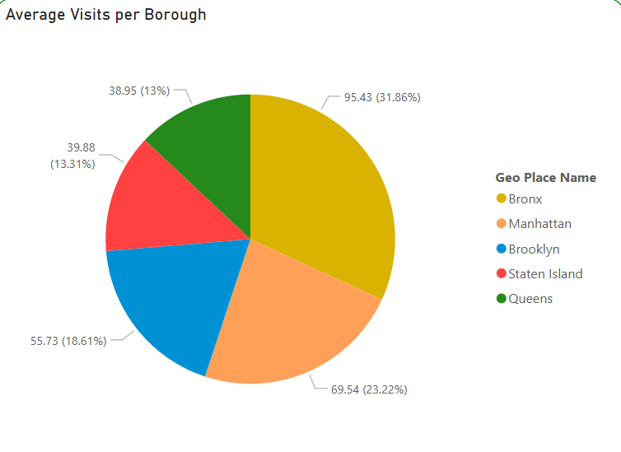
Average visits per borough
We see in this graph the average visits per borough. The analysis found that the borough where there was most visits was the Bronx along the years 2005-2017. Represents the 31.6 % of the total average of the people with an average of 95.43 per 100,000 adults. Note: In all the years the borough with more average visits is the Bronx

Slide 17
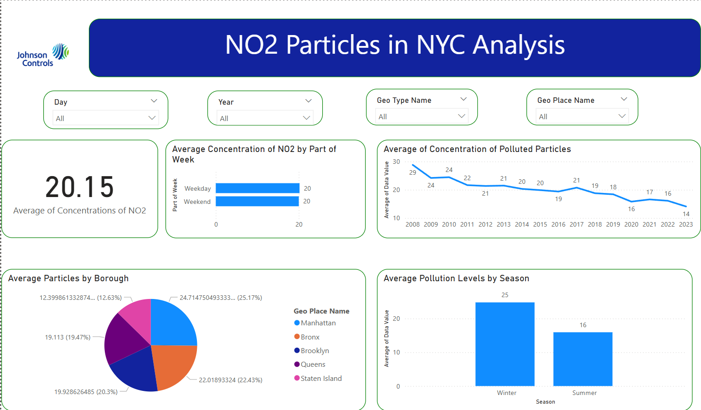
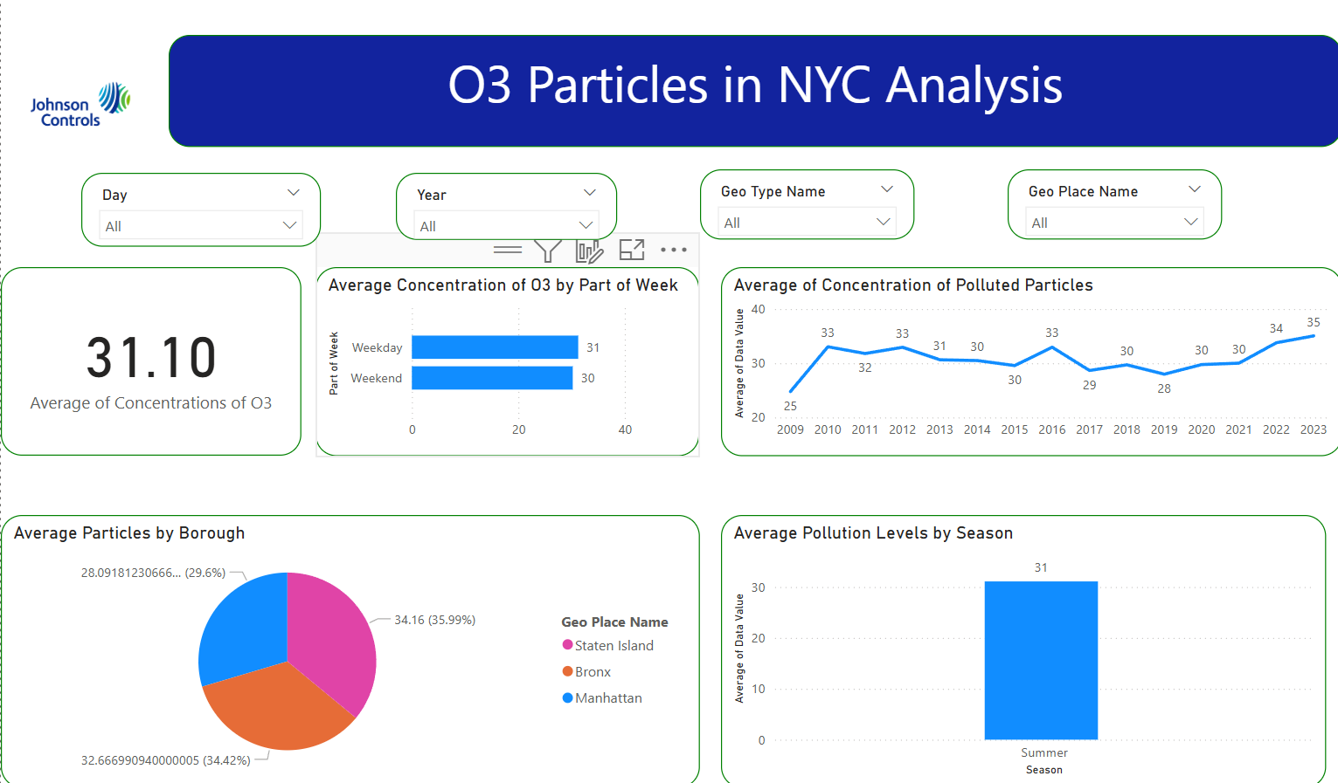
Dashboards for o3 and no2

Slide 18
Conclusions
In this report we found some useful insights on how much the polluted particles spread along all NYC using variables as Borough, See time patterns who can help us out to see which are the decisions and action plan to control this type of concentrations who can create diseases for the people, and this help us to find some areas where it needs to take action. Also the visits to the asthma emergency room show us the impact that the particles spreading is having in the health of the persons.

Slide 19
Recommendations
In the last year the borough with most SM 2.5 particles was the Bronx. E average concentration also is bigger in 2023 than 2022. I suggest they put more green initiatives like indoor air quality standards in the buildings and keep promoting renewable energy in undeserved neighborhoods
A lot of persons use the public transportation in NYC and being a city with high population it would be a great idea to electrify the public transportation
Also start to implement geothermal and electric systems for heating can help the indicators to reduce the concentrations of the particles

